Slide 1


Foundations of
Scientific Computing
Dave Biersach
dbiersach@bnl.gov
Task 03
Brownian Motion

Slide 2
Task 03
Write a Python program called random_walk.py that displays a 2D Cartesian plot of a meandering path
The walker starts at the (0,0) origin and takes one step at a time
At each step, the walker picks a random angle (uniform distribution) within the interval $[0,2π)$ and moves (from its current position) a distance of 1 in that radial direction
Show the entire journey of 10,000 random steps in your plot

Slide 3
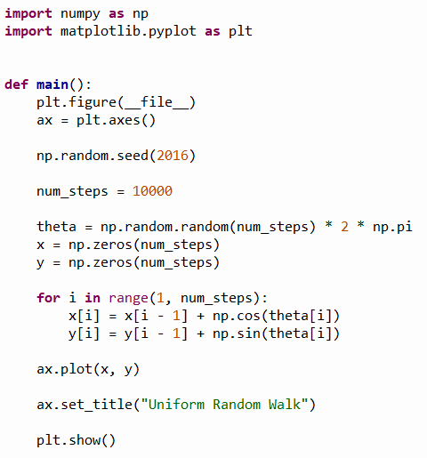
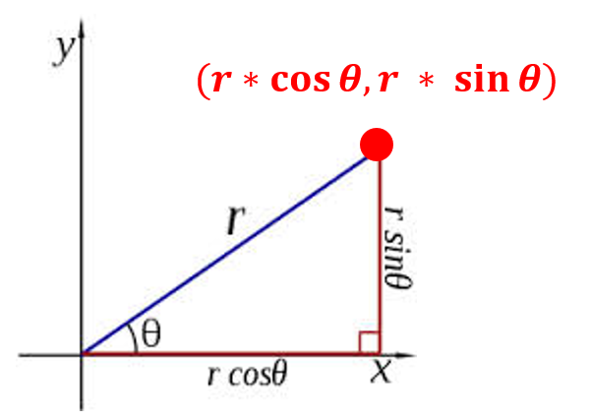
Open random_walk_instructor.py
①
②
③
x[0]=0
y[0]=0
④
⑤
⑥
⑦
⑧
⑨
⑩

Slide 4
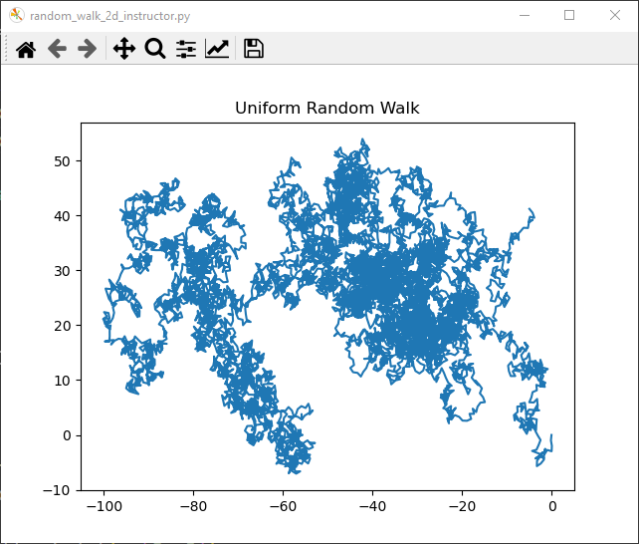
Run random_walk_instructor.py
This is just one example output

Slide 5
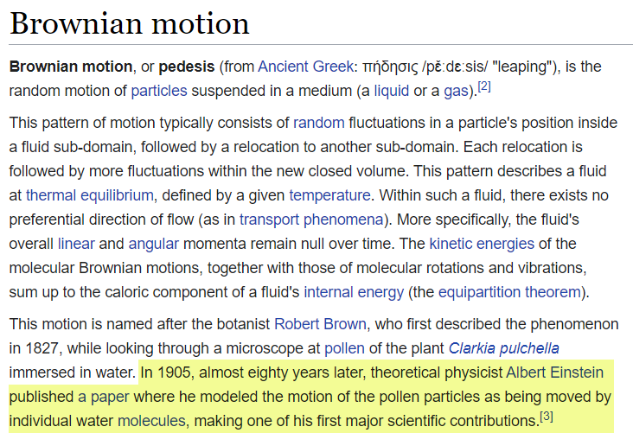
https://en.wikipedia.org/wiki/Brownian_motion

